Slide 1
Chapter 6
Basic SQL

Slide 2
Structured Query Language (SQL)
Developed at IBM by Donald D. Chamberlin and Raymond F. Boyce in the early 1970s and used in IBM System R Relational DBMS prototype.
It combines three database languages
DDL - schema creation and modification, access control;
DML - data insert, update, and delete;
QL - data query.
The most commonly used database language.
Implemented in all commercial DBMS

Slide 3
Versions
American National Standard Institute (ANSI) and International Organization for Standarization (ISO)
SQL or SQL-86
SQL1 or SQL-89 Added integrity constraints
SQL2 or SQL-92 Major revision, many new types and operations (union, intersection, minus njoin), ALTER, DROP
SQL3 or SQL-99 Added recursive queries, triggers, object-relational features (structured types), embedded SQL in Java
Not fully supported in any DBMS
SQL4 or SQL:03 Introduced XML-related features, auto generated values (identity-columns)
SQL5 or SQL:06 Importing, storing and querying XML data
SQL6 or SQL:08 Added INSTEAD OF Trigger, TRUNCATE
SQL7 or SQL:11 Added support for temporal databases

Slide 4
SQL = DDL + DML + QL
Data Definition Language (DDL):
Used to specify the conceptual schema, storage, and view of a database:
create, alter, drop clauses
Data Manipulation Language (DML):
Used to specify database updates
Insert, delete, update clauses
Query Language (QL):
Used to specify database retrievals
select clause

Slide 5

Schema and Catalog Concepts in SQL
Schema elements include
Tables,
Constraints,
Views,
Domains, and
Storage structures
… Other constructs
Each statement in SQL ends with a semicolon
View
…
View
Conceptual schema
Internal schema
Metadata
Database

Slide 6
SQL Data Definition Language (DDL)
CREATE TABLE (or VIEW)
create a named table and its structure
attributes, data types ...
integrity constraints such as key, foreign key, unique, not all, check, ...
what users can access
ALTER TABLE
modify an existing table’s structure
DROP TABLE
drop an existing table
View
…
View
Conceptual schema
Internal schema
Metadata
Database

Slide 7
CREATE TABLE
Two kinds of relations in RDB:
Base relations (base tables)
Created through the CREATE TABLE statement. The relation and its tuples are actually created and stored as a file by the DBMS
Virtual relations (views)
Created through the CREATE VIEW statement and defined as a query. Do not correspond to any physical file.
View
…
View
Conceptual schema
Internal schema
Metadata
Database

Slide 8
Sample Relations
Student |  |  |  | Grade |  |  |  | Course
S# | SNAME | AGE |  | S# | C# | MARK |  | C# | CNAME | LOC
1000 | John | 25 |  | 1000 | CS300 | 90 |  | CS300 | OS | ME300
2000 | Kate | 24 |  | 1000 | CS305 | 85 |  | CS305 | DB | UC231
3000 | Tony | 20 |  | 2000 | CS300 | 85 |  | MT230 | AL | TB300
Relation names
Attributes (column names)
Value types
Integrity Constraints
primary key
foreign key
unique
not null
check

Slide 9
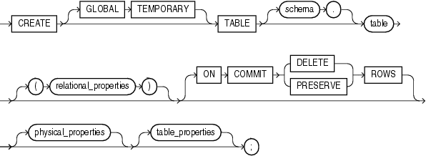
CREATE TABLE SYNTAX
Two kinds of tables can be created with it:
base table that stays in the system until it is dropped
temporary table that is may be deleted when the program COMMIT or when the session terminate.
Notes:
The data in a global temporary table is private, such that data inserted by a session can only be accessed by that session. The session-specific rows in a global temporary table can be preserved for the whole session, or just for the current transaction.
The ON COMMIT DELETE ROWS clause indicates that the data should be deleted at the end of the transaction, or the end of the session.

Slide 10
Temporary Table Example
ON COMMIT DELETE ROWS
CREATE GLOBAL TEMPORARY TABLE TempTable (
id NUMBER,
description VARCHAR2(20)
) ON COMMIT DELETE ROWS;
DBMS will delete all its rows when the session commits
ON COMMIT PRESERVE ROWS
CREATE GLOBAL TEMPORARY TABLE TempTable (
id NUMBER,
description VARCHAR2(20)
) ON COMMIT PRESERVE ROWS;
DBMS will delete all its rows when the session is terminated.

Slide 11
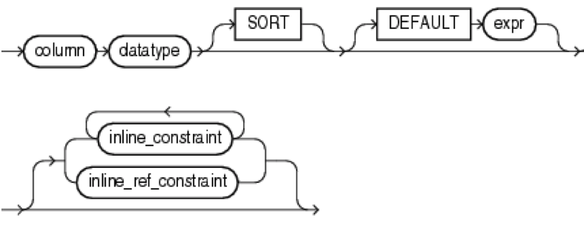
Relation Properties
Inline Constraint
to define one or more integrity constraints as part of the column definition using UNIQUE, NOT NULL, CHECK, PRIMARY KEY, and REFERENCES.
Off line Constraint
is used to define an integrity constraint as part of the table definition (after column definitons).

Slide 12
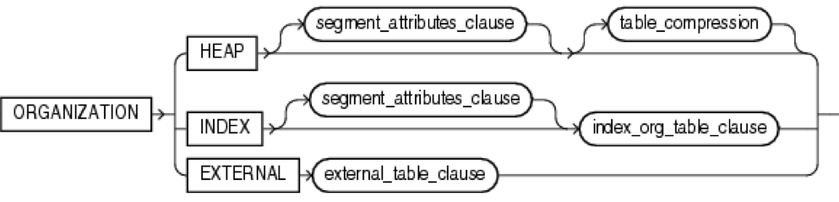
Physical Organization
HEAP
Data rows of table are stored in no particular order (default).
INDEX
table is created as an index-organized table. In an index-organized table, the data rows are held in an index defined on the primary key for the table.
EXTERNAL
indicates that table is a read-only table located outside the database.

Slide 13
Attribute Data Types and Domains
Basic data types
Numeric data types
Integer numbers: INTEGER, INT, and SMALLINT
Floating-point (real) numbers: FLOAT or REAL, and DOUBLE PRECISION
Character-string data types
Fixed length: CHAR(n), CHARACTER(n)
Varying length: VARCHAR(n), CHAR VARYING(n), CHARACTER VARYING(n), VARCHAR2(n)

Slide 14
Attribute Data Types and Domains
Bit-string data types
Fixed length: BIT(n)
Varying length: BIT VARYING(n)
Boolean data type
Values of TRUE or FALSE or NULL
DATE data type
Ten positions
Components are YEAR, MONTH, and DAY in the form YYYY-MM-DD
Multiple mapping functions available in RDBMSs to change date formats

Slide 15
Attribute Data Types and Domains
Additional data types
Timestamp data type
Includes the DATE and TIME fields
Plus a minimum of six positions for decimal fractions of seconds
Optional WITH TIME ZONE qualifier
INTERVAL data type
Specifies a relative value that can be used to increment or decrement an absolute value of a date, time, or timestamp
DATE, TIME, Timestamp, INTERVAL data types can be cast or converted to string formats for comparison.

Slide 16
Attribute Data Types and Domains
Domain
Name used with the attribute specification
Makes it easier to change the data type for a domain that is used by numerous attributes
Improves schema readability
Example:
CREATE DOMAIN SIN_TYPE AS CHAR(9);
TYPE
User Defined Types (UDTs) are supported for object-oriented applications. (See Ch.12) Uses the command: CREATE TYPE

Slide 17
CREATE TABLE
Specifies a new base relation by
giving it a name,
specifying each of its attributes and their data types,
defining constraints
Types
INTEGER,
FLOAT,
DECIMAL(i,j),
CHAR(n),
VARCHAR(n)
Constraints
PRIMARY KEY
FOREIGN KEY
UNIQUE
NOT NULL

Slide 18
Sample Relations
Student |  |  |  | Grade |  |  |  | Course
S# | SNAME | AGE |  | S# | C# | MARK |  | C# | CNAME | LOC
1000 | John | 25 |  | 1000 | CS300 | 90 |  | CS300 | OS | ME300
2000 | Kate | 24 |  | 1000 | CS305 | 85 |  | CS305 | DB | UC231
3000 | Tony | 20 |  | 2000 | CS300 | 85 |  | MT230 | AL | TB300
CREATE TABLE STUDENT ( S# CHAR(4) Primary Key, SNAME VARCHAR(10) NOT NULL, AGE INTEGER );
CREATE TABLE COURSE ( C# CHAR(5) Primary Key, CNAME VARCHAR(10) Not Null Unique, LOC CHAR(5));
inline
inline

Slide 19
Sample Relations
Student |  |  |  | Grade |  |  |  | Course
S# | SNAME | AGE |  | S# | C# | MARK |  | C# | CNAME | LOC
1000 | John | 25 |  | 1000 | CS300 | 90 |  | CS300 | OS | ME300
2000 | Kate | 24 |  | 1000 | CS305 | 85 |  | CS305 | DB | UC231
3000 | Tony | 20 |  | 2000 | CS300 | 85 |  | MT230 | AL | TB300
CREATE TABLE GRADE (
S# CHAR(4) ,
C# CHAR(10) ,
MARK INTEGER,
PRIMARY KEY (S#,C#),
FOREIGN KEY (S#) REFERENCES Student(S#)
ON DELETE CASCADE,
FOREIGN KEY (C#) REFERENCES Course(C#)
ON DELETE CASCADE);
PRIMARY KEY, ?
Cannot have more
than one primary key
PRIMARY KEY, ?
Offline

Slide 20
Specifying Constraints in SQL
Basic constraints:
Relational Model has 3 basic (built-in) constraint types that are supported in SQL:
Key constraint: A primary key value cannot be duplicated
Entity Integrity Constraint: A primary key value cannot be null
Referential integrity constraints : The “foreign key “ must have a value that is already present as a primary key, or may be null.

Slide 21
Example
Employee
E# | Name | Age | Mgr
1000 | John | 25 | 2000
2000 | Kate | 30
3000
Key constraint:
A primary key value cannot be duplicated
Entity Integrity Constraint:
A primary key value cannot be null
Referential integrity constraints :
The “foreign key “ must have a value that is already present as a primary key, or may be null.

Slide 22
Specifying Key Constraints in SQL
PRIMARY KEY clause
Specifies one or more attributes that make up the primary key of a relation
D# INTEGER PRIMARY KEY;
PRIMARY KEY(S#,C#);
UNIQUE clause
Specifies alternate (secondary) keys
NAME VARCHAR(15) UNIQUE;
NOT NULL clause
Specifies the attribute value cannot be null
AGE INT NOT NULL;
PRIMARY KEY contains UNIQUE, NOT NULL

Slide 23
Referential Integrity Options
We can specify one the following options on referential integrity constraints (foreign keys)
RESTRICT,
CASCADE,
SET NULL,
SET DEFAULT.

Slide 24
Referential Integrity Example
Dept |  |  |  | Employee
D# | Name | Mgr |  | E# | Name | Age | Dept | Mgr
1 | Sales | 2000 |  | 1000 | John | 25 | 1 | 2000
2 | Design |  |  | 2000 | Kate | 30 | 1
CREATE TABLE DEPT (
D# INTEGER PRIMARY KEY,
NAME VARCHAR(10) NOT NULL,
MGR CHAR(9) DEFAULT 2000,
UNIQUE (NAME),
FOREIGN KEY (MGR) REFERENCES EMPLOYEE (E#) ON DELETE SET DEFAULT ON UPDATE CASCADE);
This has problem because of circular references. Solution:
CREATE TABLE EMPLOYEE;

Slide 25
Referential Integrity Example
Dept |  |  |  | Employee
D# | Name | Mgr |  | E# | Name | Age | Dept | Mgr
1 | Sales | 2000 |  | 1000 | John | 25 | 1 | 2000
2 | Design |  |  | 2000 | Kate | 30 | 1
CREATE TABLE EMPLOYEE (
E# CHAR(4) PRIMARY KEY,
NAME VARCHAR(10) NOT NULL,
AGE INTEGER,
DEPT INTEGER DEFAULT 1,
MGR CHAR(4),
FOREIGN KEY (DEPT) REFERENCES DEPT (D#) ON DELETE SET DEFAULT ON UPDATE CASCADE,
FOREIGN KEY (MGR) REFERENCES EMPLOYEE (E#) ON DELETE SET DEFAULT ON UPDATE CASCADE);

Slide 26
DROP TABLE
Used to remove a relation (base table) and its definition
DROP TABLE GRADE;
DROP TABLE STUDENT;
DROP TABLE COURSE;
The relation can no longer be used in queries, updates, or any other commands since its description no longer exists
Student |  |  |  | Grade |  |  |  | Course
S# | SNAME | AGE |  | S# | C# | MARK |  | C# | CNAME | LOC
1000 | John | 25 |  | 1000 | CS300 | 90 |  | CS300 | OS | ME300
2000 | Kate | 24 |  | 1000 | CS305 | 85 |  | CS305 | DB | UC231
3000 | Tony | 20 |  | 2000 | CS300 | 85 |  | MT230 | AL | TB300

Slide 27
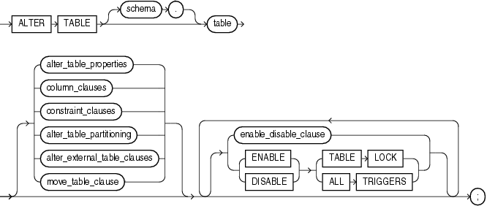
ALTER TABLE
Add, delete, modify attribute definitions of the table

Slide 28

ALTER TABLE
Used to add an attribute to one of the base relations
ALTER TABLE Student ADD PHONE VARCHAR(10);
The new attribute will have NULLs in all the tuples of the relation right after the command is executed; hence, the NOT NULL constraint is not allowed for such an attribute
The database users must still enter a value for the new attribute phone for each student tuple.
This can be done using the UPDATE command.
Student
S# | SNAME | AGE
1000 | John | 25
2000 | Kate | 24
3000 | Tony | 20
Student
S# | SNAME | AGE | PHONE
1000 | John | 25
2000 | Kate | 24
3000 | Tony | 20

Slide 29
Metadata
USER_TABLES
TABLE_NAME | TABLESPACE_NAME | …
STUDENT | SYSTEM
COURSE | SYSTEM
GRADE | SYSTEM
...
USER_TAB_COLUMNS
TABLE_NAME | COLUMN_NAME | DATA_TYPE | …
STUDENT | S# | CHAR
STUDENT | SNAME | VARCHAR2
STUDENT | AGE | NUMBER
COURSE | C# | CHAR
...

Slide 30

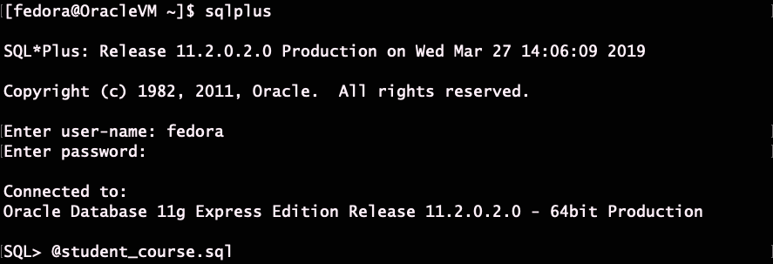
Find schema information

Slide 31

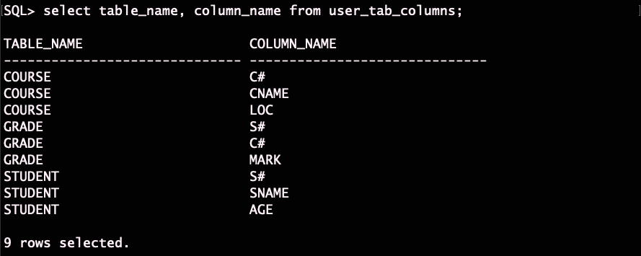
Find schema information

Slide 32
SQL Data Manipulation Language (DML)
Three commands used to modify the database:
Insert
Insert one tuple into a base relation
Delete
delete one or more tuples in a base relation
Update
modify one or more tuples in a base relation
View
…
View
Conceptual schema
Internal schema
Metadata
Database

Slide 33
INSERT
Student |  |  |  | Grade |  |  |  | Course
S# | SNAME | AGE |  | S# | C# | MARK |  | C# | CNAME | LOC
1000 | John | 25 |  | 1000 | CS300 | 90 |  | CS300 | OS | ME300
2000 | Kate | 24 |  | 1000 | CS305 | 85 |  | CS305 | DB | UC231
3000 | Tony | 20 |  | 2000 | CS300 | 85 |  | MT230 | AL | TB300
insert into student
values ('1000', 'John', 25);
insert into student
values ('2000', 'Mary', 30);
insert into student
values ('3000', 'Jack', 20);
Attribute values should be listed in the same order as the attributes were specified in the CREATE TABLE command
insert into student(S#,SNAME)
values ('1000', 'John');
Student
S# | SNAME | AGE
1000 | John
insert into student
values ('1000', 'John’, null);

Slide 34
INSERT
Constraints on data types are observed automatically
Any integrity constraints as a part of the DDL specification are enforced
View
…
View
Conceptual schema
Internal schema
Metadata
Database

Slide 35
DELETE
Removes one or more tuples from a relation
DELETE FROM <table> WHERE condition;
The WHERE-clause specifies the tuples to be deleted
Referential integrity should be enforced
Tuples are deleted from only one table at a time (unless CASCADE is specified on a referential integrity constraint)
The number of tuples deleted depends on the number of tuples in the relation that satisfy the WHERE-clause

Slide 36
DELETE
Student |  |  |  | Grade |  |  |  | Course
S# | SNAME | AGE |  | S# | C# | MARK |  | C# | CNAME | LOC
1000 | John | 25 |  | 1000 | CS300 | 90 |  | CS300 | OS | ME300
2000 | Kate | 24 |  | 1000 | CS305 | 85 |  | CS305 | DB | UC231
3000 | Tony | 20 |  | 2000 | CS300 | 85 |  | MT230 | AL | TB300
Removes one or more tuples from a relation
DELETE FROM STUDENT WHERE SNAME = 'John';
DELETE FROM STUDENT WHERE AGE > 20;
DELETE FROM STUDENT;
A missing WHERE-clause specifies that all tuples in the relation are to be deleted; the table then becomes an empty table

Slide 37
UPDATE
Modify attribute values of one or more selected tuples
UPDATE <Table>
SET <attribute> = <value>
WHERE Condition;
The WHERE-clause selects the tuples to be modified
The SET-clause specifies the attributes to be modified and their new values
Each command modifies tuples in the same relation
Referential integrity specified as part of DDL specification is enforced

Slide 38
UPDATE Example
Student |  |  |  | Grade |  |  |  | Course
S# | SNAME | AGE |  | S# | C# | MARK |  | C# | CNAME | LOC
1000 | John | 25 |  | 1000 | CS300 | 90 |  | CS300 | OS | ME300
2000 | Kate | 24 |  | 1000 | CS305 | 85 |  | CS305 | DB | UC231
3000 | Tony | 20 |  | 2000 | CS300 | 85 |  | MT230 | AL | TB300
UPDATE GRADE
SET MARK = 90
WHERE S#='1000' and C#='CS305';
UPDATE STUDENT
SET AGE = AGE + 1;
A missing WHERE-clause specifies that all tuples in the relation are to be updated

Slide 39
SQL = DDL + DML + QL
Data Definition Language (DDL):
Used to specify the conceptual schema, storage, and view of a database:
create, alter, drop clauses
Data Manipulation Language (DML):
Used to specify database updates
Insert, delete, update clauses
Query Language (QL):
Used to specify database retrievals
select clause

Slide 40
Relational Languages
Relational Algebra (ALG)
Various operations
High level procedural language
Tuple Relational Calculus (TRC)
Tuple variables in logical formulas
Declarative language
Domain Relational Calculus (DRC)
Domain variables in logical formulas
Declarative language

Slide 41
Characteristics of SQL
SQL allows declarative queries while hiding query execution (algebra) details;
Implemented in all commercial DBMS and allows easy portability between database systems (standard RDB language);
SQL is widely known by database developers and database administrators;
Supporting SQL allows interact with other systems that use SQL and JDBC/ODBC;
SQL is called a 4th generation language, isolating users and programmers from writing complicated data manipulation code, letting the database administrators administrate database tasks.

Slide 42
SQL Design Issues
User-friendly: English like syntax, with Minimal set of keywords
select, from, where
group by, having
order by
distinct, etc
Combine two TRC steps in one SQL statement
List the student name for students with average mark greater than 80
TRC> T(NAME, AVG) := {S.sname, avg(G.mark) | S in Student and G in Grade and S.S# = G.S#};
TRC> {S.name | S in T and S.AVG > 80};
SQL> Select S.sname From Student S, Grade G Where S.S# =
G.S# Group by S.sname Having avg(G.Mark) > 80;

Slide 43
SQL Query Language
Relational Algebra (ALG)
UNION
INTERSECT
MINUS
JOIN
OUTERJOIN
Tuple Relational Calculus (TRC)
{VA ₁, …, VA _{n} | Various Formulas } orderby …
Result
SELECT
Memberships
FROM
Conditions
WHERE
ORDERBY
Aggregate
GROUP BY

Slide 44
SQL Query Language
SELECT [DISTINCT] items
attribute names whose values are to be retrieved by the query
FROM tables
list of the relation names required to process the query
[WHERE conditions]
conditions on tuples
[GROUP BY columns]
for min, max, count, total, average on groups
[HAVING condition]
conditions on grouping
[ORDER BY columns]
sorting the result DESC|ASC

Slide 45
SQL Design Issues
English like syntax, so it is user-friendly
Minimal set of keywords
select, from, where
group by, having
order by
distinct, etc
Combine two steps in one SQL statement
List the student name for students taking more than one course
T(SNAME, C) := {S.sname, count(*) | S in Student and
(exist G in Grade) (S.S# = G.S#)};
{P.sname | P in T and P.C > 1};

